Slide 1
Customer Personality Analysis
Presented by: Gebran Assaad
Kim Haykal

Slide 2
Table of contents
01
02
03
04
05
06
Introduction
Preparation
Clustering
Models
Conclusion
Références

Slide 3

01
Introduction

Slide 4

02 Preparation
First-year revenue of the project

Slide 5
Preparation
Missing Values
Outliers Detection
Transformation and Adding new Variables
Income: 2240×1 double
Values:
Min 1730
Median 51382
Max 6.6667e+05
NumMissing 24
So there are 24 values that are missing. We choose to fill them with the average of the variable 'Income'.
We modify some features as well as create new ones for further analysis and modeling
Ex: Age, Education and Total Spent
To detect outliers in this dataset, we chose to draw 2 boxplots for the variables "Age" and "Income" so we can see which observations we should delete.

Slide 6
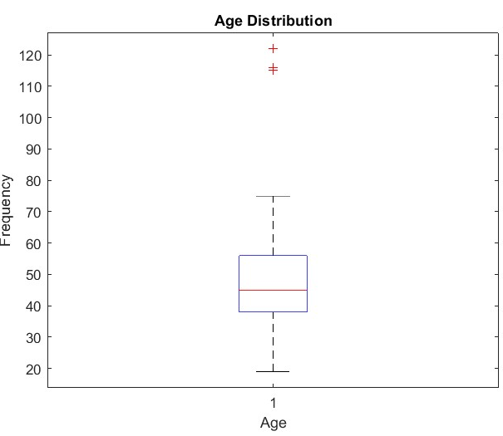
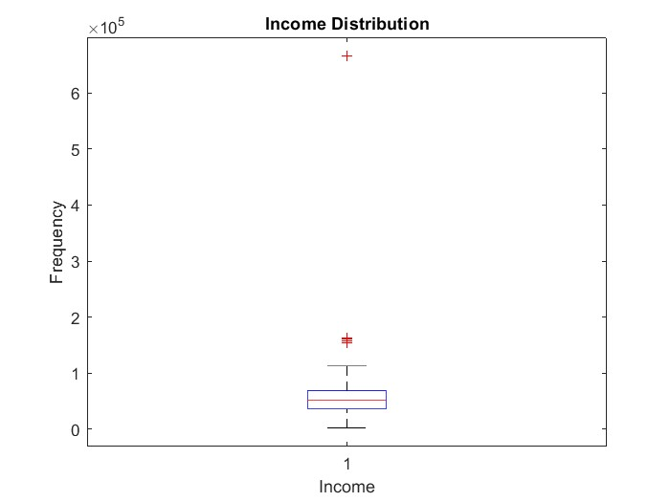
Boxplots

Slide 7

03
Clustering

Slide 8
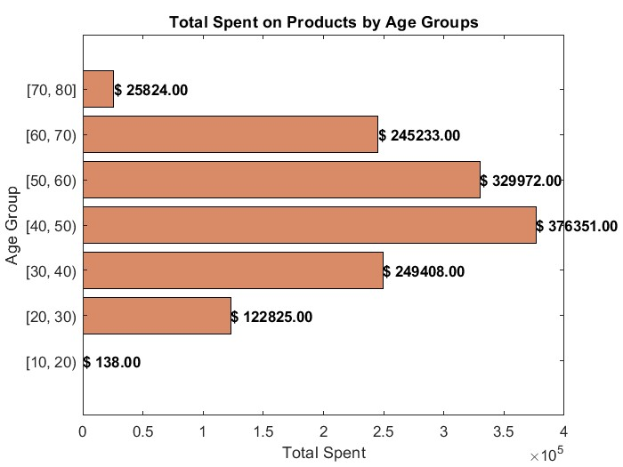
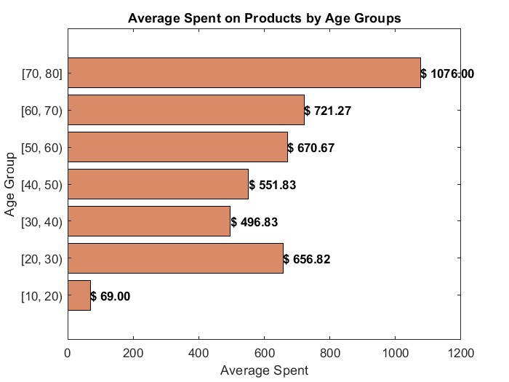


Clustering: Visualization

Slide 9
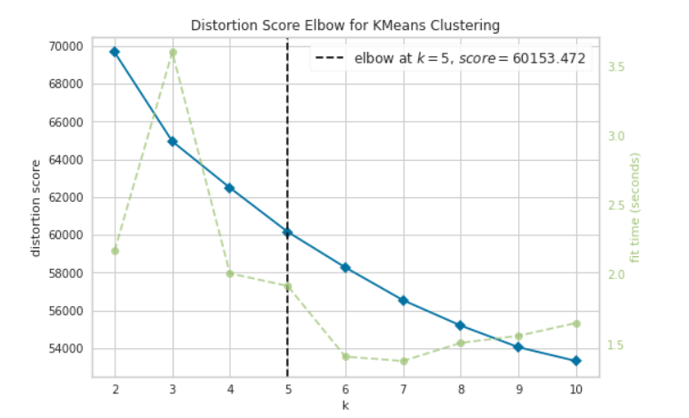
Clustering: Elbow Method
elbow = KElbowVisualizer(KMeans(random_state=123), k=10)
elbow.fit(df_final_scaled)
elbow.show()

Slide 10
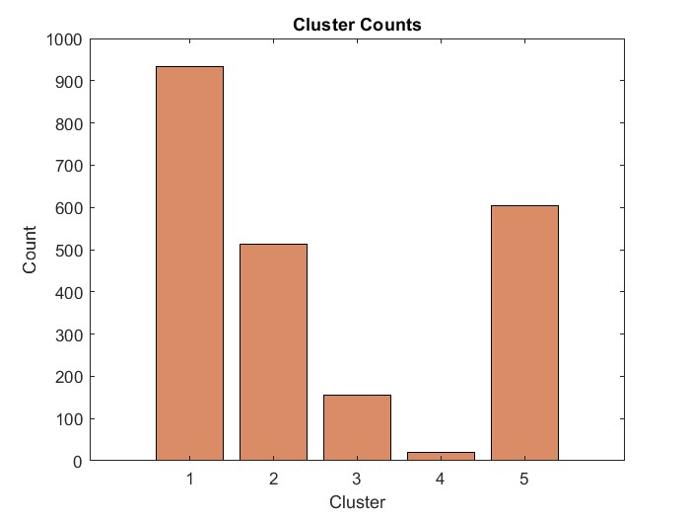
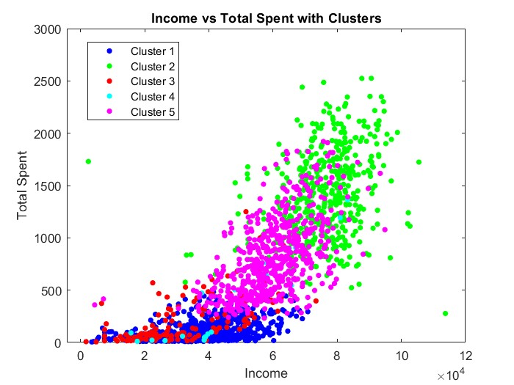
Clustering: Clusters
1:
Low spending and average income
2:
Highest spending and income
3:
Low spending and income
4:
Lowest spending and income
5:
Average spending and income

Slide 11
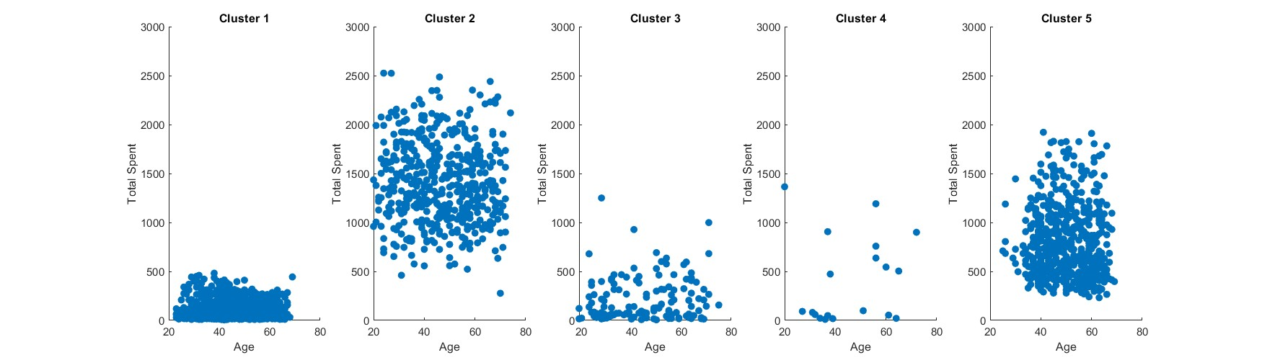
Clustering: Cluster Profiling Age

Slide 12
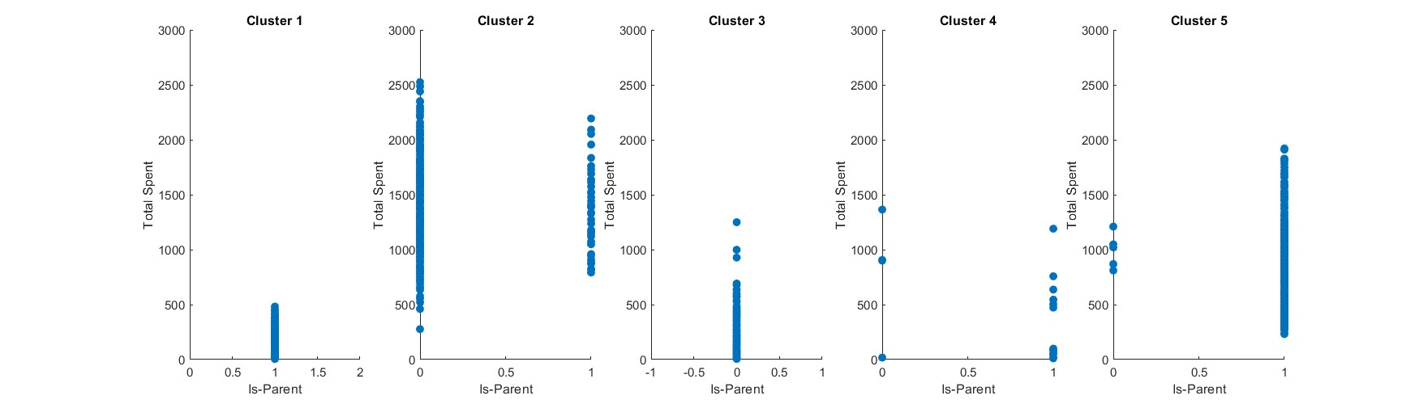
Clustering: Cluster Profiling Is-Parent

Slide 13
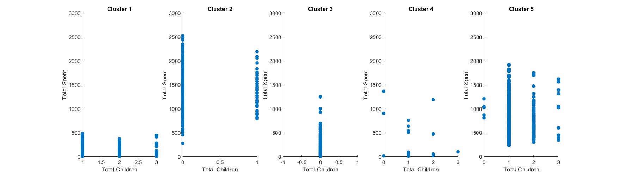
Clustering: Cluster Profiling Total Children

Slide 14
Clustering: Cluster Profiling Results:
Cluster 1:
Low spending and average income
Most of them are between 20 and 60
All of them are a parent
Have a max 3 children
Cluster 2:
Highest spending and income
Span all ages
Most of them are not a parent
Max 1 Children
Cluster 3:
Low spending and income
Span all ages
All of them are not a parent
Cluster 5:
Average spending and income
Most of them are between 20 and 60
Most of them are a parent
Most of thme have one or two children
Cluster 4:
Lowest spending and income
Span all ages
Most of them are a parent
Have a max 3 children

Slide 15
04
Models

Slide 16
Models: With “Dividerrand()”
Training,Validation and Test
KNN
With “Dividerrand” function we split the dataset into:
Training set: 70% (1560)
Validation set: 20% (446)
Test set: 10% (223)
For k = 3: Acc = 95.51%
For k = 5: Acc = 94.61%
For k = 7: Acc = 95.96%
Decision Tree
SVM
Acc = 95.06%
Precision = 95.60%
Recall = 98.86%
F1-score = 97.21%
Before:
Acc = 12.55%
Precision = 12.96%
Recall = 15.91%
F1-score = 14.29%
After:
Acc = 98.20%
Precision = 100%
Recall = 97.73%
F1-score = 98.85%

Slide 17
Models: With “cvpartition”(HoldOut)
Training,Validation and Test
KNN
With “Dividerrand” function we split the dataset into:
Training set: 60%
Validation set: 20%
Test set: 20%
For k = 3: Acc = 95.96%
For k = 5: Acc = 95.74%
For k = 7: Acc = 95.96%
Decision Tree
SVM
Acc = 95.51%
Precision = 99.47%
Recall = 97.93%
F1-score = 98.69%
Before:
Acc = 8.29%
Precision = 33.33%
Recall = 4.15%
F1-score = 7.37%
After:
Acc = 98.65%
Precision = 100%
Recall = 98.45%
F1-score = 99.22%

Slide 18
Clustering: Confusion Matrix SVM
Actual Values
1
2
3
4
5
1
86 | 0 | 0 | 0 | 2
0 | 62 | 0 | 0 | 1
0 | 0 | 8 | 0 | 0
0 | 0 | 0 | 1 | 0
0 | 1 | 0 | 0 | 62
2
3
Predicted Values
5
5
% 219 out of 223 were correctly predicted

Slide 19
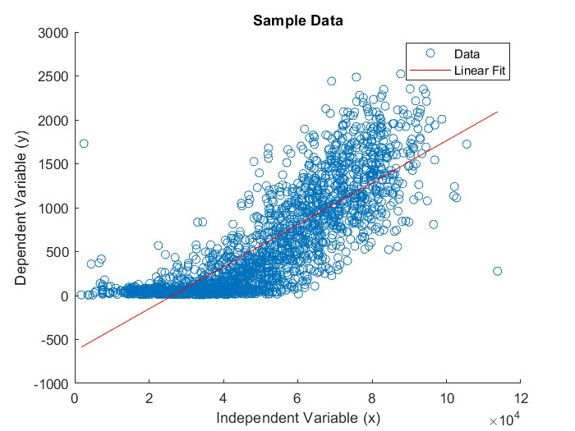
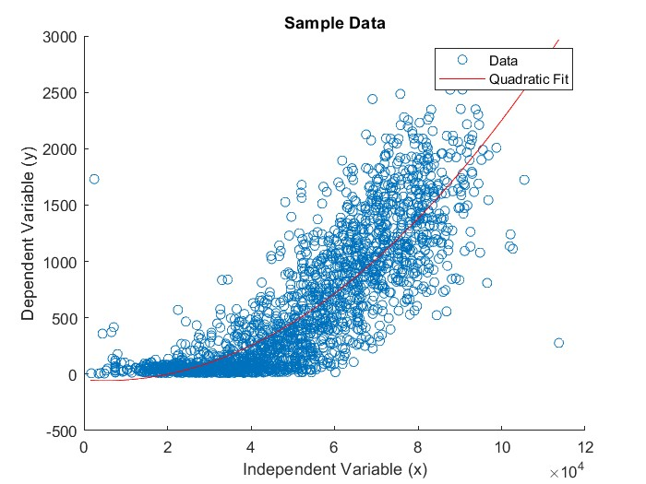
Clustering: Regressions(Income and Total Spent)
Linear:
Quadratic:
New Customer:
Income: 65400
R2 : 0.672
Predicted Spent: 935.048
R2 : 0.711
Predicted Spent: 873.90

Slide 20

05 Conclusion

Slide 21
06.References:
Dataset: https://www.kaggle.com/datasets/imakash3011/customer-personality-analysis/data
Matlab Documentation: https://www.mathworks.com/help/matlab/
Udemy: https://www.udemy.com/course/the-data-science-course-complete-data-science-bootcamp/?couponCode=LETSLEARNNOW

Slide 22
Thank You

